Slide 1
Rocks & Minerals
Coaches training
A 2018
Cave of the Crystals
Naica, Chihuahua, Mexico
http://ngm.nationalgeographic.com/2008/11/crystal-giants/shea-text

Slide 2
For the Coaches Training today:
We will review the rules and strategies to be competitive in this event.
This PowerPoint will be posted on the Delaware Science Olympiad homepage.
Click on the study tab and scroll down to resources for the division you are in.
As you go through this PowerPoint, there will be links to websites on many slides.
These links will give you and your students a place to find the information needed
to be able to answer questions at the competition.
Many of the sites are geared for B & C. Don’t let your students get overwhelmed by it.
DON’T BE DISCOURAGED BY WHAT YOU FIND ONLINE.
THERE IS MORE INFORMATION AT THESE SITES
THAN WILL EVER BE NEEDED. MOST IS FOR DIVISIONS B & C
JUST PICK OUT WHAT YOU FEEL IS CLOSEST
TO THE HEART OF THE EVENT FOR DIVISION A.
If any of the websites do not open or you get an error message,
copy and paste the link into the browser window

Slide 3
Your students will need PowerPoint
for some of the information on line.
Some computers don’t have it.
PowerPoint Viewer
It is a free download from Microsoft.
It will allow you to view PowerPoint presentations, just not create them.
The same goes for Adobe Reader,
this will let them view PDF presentations.
https://www.microsoft.com/en-us/download/details.aspx?id=13
https://get.adobe.com/reader/enterprise/

Slide 6

https://www.soinc.org
Delaware 2018 - A
1. DESCRIPTION: This event will have 20 stations that the teams will rotate through in
2 minute increments, timed by the event supervisor.
Teams may be viewing any combination of:
samples, pictures, or written descriptions of
rocks and minerals on the 2017 Delaware Division A Rocks and Minerals list.
Teams will be asked multiple questions at each station.
The questions will be:
multiple choice, fill in the blank, short answer, etc. about the sample...
or questions about rocks and minerals in general without any sample.
2. TEAM: of 1 or 2 Safety Requirements - none
3. MAXIMUM TIME: 50 min
4. TEAMS: Must bring writing instruments.
Each team may bring one magnifying glass and one three-ring binder of any size...
containing information in any form and from any source attached using the available 3 rings;
which may be removed during the event.
5. THE COMPETITION: The Teams will be assessed on their knowledge of:
The proper identification of all rocks and minerals on the 2018 Delaware Division A list.
For rocks -
a. The environments of formation of igneous, sedimentary, and metamorphic in general
b. The rock cycle
c. The formation of and the difference between the coal varieties on the list
d. Grade of metamorphism including parent rocks for the metamorphic rocks on the list
e. The classification of the rocks on the list
For minerals -
f. The methods of formation of minerals in general
g. Moh’s hardness scale
h. The habit ( botryoidal, hexagonal, prismatic, etc. ) of the minerals on the list
i. The economic importance or lack of, for the minerals on the list
6. REPRESENTATIVE STATION ACTIVITIES:
j. Identify each of the minerals and place them in the correct order according to Moh’s scale
k. Match each metamorphic rock with the type of rock from which it may have been formed
7. SCORING:
Total highest scores will determine rankings in this event.
Ties will be broken by the accuracy or quality of answers to pre-selected questions.
Recommended Resources: All reference and training resources including the Rock & Mineral
Teaching Guide (RMCD), the Bio/Earth CD (BECD) and the National Audubon Society Field
Guide to North American Rocks and Minerals are available on the Official Science Olympiad
Store or Website at www.soinc.org, and the Rocks and Minerals kits (*excluding only silver, gold,
and diamond) may be ordered from Ward’s Science Olympiad Kits.

Slide 7

https://www.soinc.org
ROCK HOUND
2018 Delaware Division A Rocks and Mineral List
For the State of Delaware, you will need to know about - Sillimanite and “ Blue Rock “ .
For Delaware,
you will need to know
the state mineral,
“Sillimanite”
and what “Blue Rock” is.
Minerals
Native Elements:
Copper
Graphite
Borates:
Ulexite
Carbonates:
Aragonite
Azurite
Calcite
Malachite
Halides:
Halits
Oxides:
Hematite
Magnetite
Sulphates:
Celelestite
Gypsum
variety - Selenite
Minerals
Sulfides:
Chalcopyrite
Galena
Pyrite
Silicates:
Sodalite
Staurolite
Feldspar-Amazonite
Garnet group:
Almandine
Mica Group:
Lepidolite
Pyroxene Group:
Rhodonite
Quartz varieties:
Amethyst
Citrine
Crystal
Milky Quartz
Rose Quartz
Rocks
Igneous:
Basalt
Diorite
Granite
Obsidian
Pumice
Scoria
Sedimentary:
Breccia
Conglomerate
Sandstone
Shale
Metamorphic:
Gneiss
Marble
Phyllite
Quartzite
Schist [Mica]
Slate
Coal varieties:
Anthracite
Bituminous
Lignite
Delaware 2018 - A

Slide 8
1. DESCRIPTION:
This event will have 20 stations that the teams will rotate through in
2 minute increments, timed by the event supervisor.
Teams may be viewing any combination of:
samples, pictures, or written descriptions of
rocks and minerals on the 2018 Delaware Division A Rocks and Minerals list.
Teams will be asked multiple questions at each station.
The questions will be:
multiple choice, fill in the blank, short answer, etc. about the sample...
or questions about rocks and minerals in general without any sample.
2. TEAM: of up to: 2 Safety Requirements - none
3. MAXIMUM TIME: 50 min
4. TEAMS:
Each team may bring one magnifying glass and one three-ring binder of any size...
containing information in any form and from any source attached using the available 3 rings;
which may be removed during the event.

Slide 9
5. THE COMPETITION: The Teams will be assessed on their knowledge of:
The proper identification of all rocks and minerals on the 2017 Delaware Division A list
For rocks -
a. The environments of formation of igneous, sedimentary, and metamorphic in general
b. The rock cycle
c. The formation and difference between the coal varieties on the list
d. Grade of metamorphism including parent rocks for the metamorphic rocks on the list
e. The classification of the rocks on the list
For minerals -
f. The methods of formation of minerals in general
g. Moh’s hardness scale
h. The habit ( botryoidal, hexagonal, prismatic, etc. ) of the minerals on the list
i. The economic importance or lack of, for the minerals on the list

Slide 10
6. REPRESENTATIVE STATION ACTIVITIES:
j. Identify each of the minerals and place them in the correct order
according to Moh’s scale
k. Match each metamorphic rock with the type of rock
from which it may have been formed

Slide 11
7. SCORING:
Total highest scores will determine rankings in this event.
Ties will be broken by the accuracy or quality of answers to pre-selected questions.
Recommended Resources:
Even though these are for Divisions B & C, they will give helpful insight to division A
All reference and training resources
including the Rock & Mineral Teaching Guide (RMCD),
the Bio/Earth CD (BECD)
and the National Audubon Society Field Guide to North American Rocks and Minerals
are available on the Official Science Olympiad Store or Website at www.soinc.org,
and the Rocks and Minerals kits (*excluding only silver, gold, and diamond)
may be ordered from Ward's Science Olympiad Kits.
( As well as:
Peterson Field Guide to Rocks and Minerals
Simon & Schuster's Guide to Rocks & Minerals )

Slide 12
What to expect
There are 20 stations around the perimeter of the room.
The students will rotate from station to station.
Some boxes will have samples with questions,
others will just have questions.
The number of questions per station will vary
There will only be 2 minutes per station.
This is all that time allows.

Slide 13
Good advice I can give you!
Create a Rocks & Minerals folder on your hard drive.
Then create sub-folders for all the different sections of this event.
As you visit the different web sites –
copy the website from the browser to a Word doc.
or better yet, download and save the page / file to these folders.
You can waste hours
trying to go back to the one page on the internet that you need.
When it’s saved to your computer,
you can find what your looking for immediately!
From there, you can easily print it and put it into your binder.
If you have EDMODO,
your students can work on this event from school and at home.

Slide 14
General Resources for this event:
Have your students review these sites.
They contain information on all aspects of the competition.
http://soinc.org/
The home page for the Science Olympiad
You can find information on all events, not just Rocks and Minerals.
https://www.soinc.org/rocks_minerals_b for both B or C
Here you will find the 2017 Rocks and Minerals list,
all the useful resources and links
and a link to Ward’s Science to purchase Rocks and Minerals kits
http://scioly.org/wiki/index.php/Main_Page
The best place for information on all B & C events.
For Rocks and Minerals, scroll down and click on the Rocks and Minerals link
in either the B or C column.
This is a good outline to begin gathering information on the Rocks and Minerals event.
http://scioly.org/wiki/index.php/2017_Test_Exchange#Rocks_and_Minerals
sample tests
http://scioly.org/users/balsa/public/ScienceOlympiadTester/index.html
https://www.learner.org/interactives/rockcycle/types3.html
Will give practice tests on Rocks and Minerals ( uncheck entomology )
If the links don’t work, copy & paste them into your browser

Slide 15
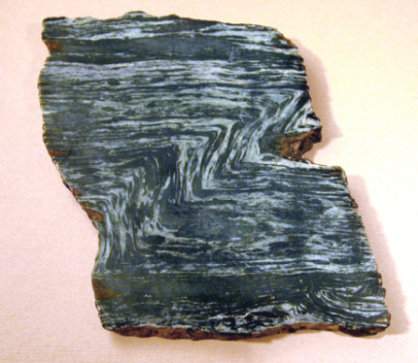
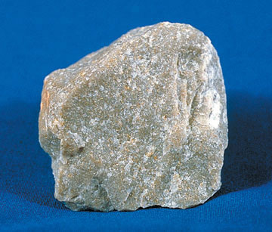
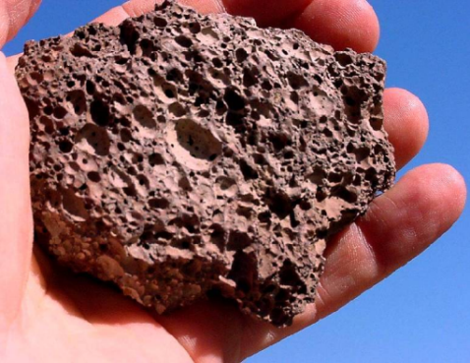
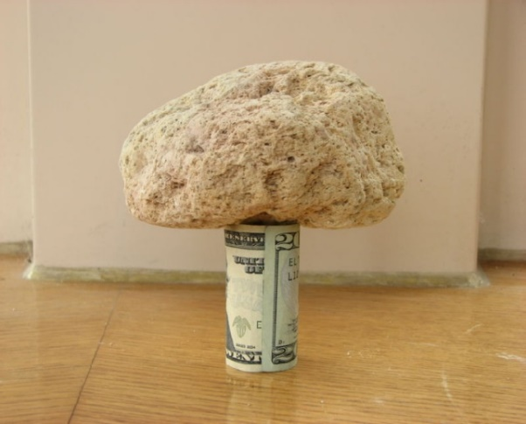
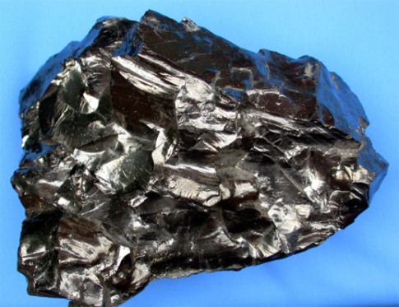
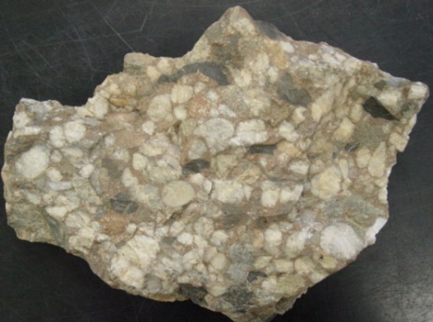
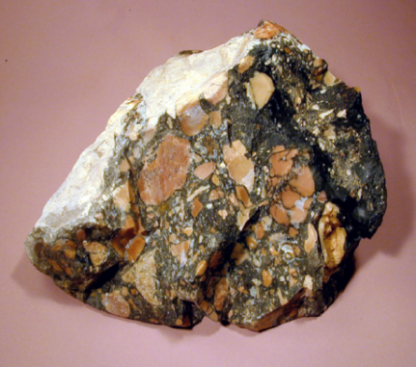
5. specimen identification - Rocks

Slide 16
5. specimen identification - Rocks
Proper identification has been the issue... that the students have had the most difficulty with.
If the specimen is not properly identified, all of the answers are incorrect.
http://scioly.org/wiki/index.php/Rocks_and_Minerals
A general description of the 3 classes of rocks.
here is a good site to help you quickly identify rocks
http://www.google.com/url?sa=t&rct=j&q=&esrc=s&source=web&cd=1&ved=0ahUKEwjH_puXkYvPAhXDGh4KHUmoCvYQFggeMAA&url=http%3A%2F%2Fwww.iroquoiscsd.org%2Fcms%2Flib%2FNY19000365%2FCentricity%2FDomain%2F76%2FLab%2520Practical%2520-%2520Rock%2520ID%2520Review.ppt&usg=AFQjCNGlVGoRk6tHlAPdW3Od-myliFciQg
click “save” to one of the folders you have created on you hard drive.
Here is another good site for looking at pictures of rocks and get additional information.
http://csmres.jmu.edu/geollab/fichter/MetaRx/index.html

Slide 17
5. specimen identification - Rocks
Sillimanite ( the Delaware State mineral )
and Brandywine Blue Rock
Both will be in this years competition.
the Delaware Mineralogical Society has good information.
Type each of them into the search box. The students do not have to look at all the ads or links.
http://www.delminsociety.net/

Slide 18
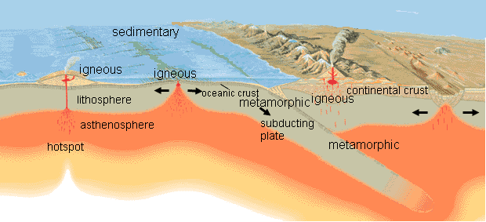
5 – a. Environments of Formation of
igneous, sedimentary, and metamorphic rocks
http://schools.bcsd.com/fremont/4th_sci_earth_rock_cycle.htm
http://www.rockhounds.com/rockshop/rockkey/
Sites with good general information

Slide 19
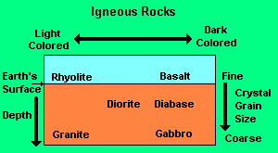
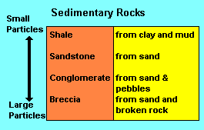
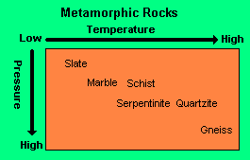
5 – a. Environments of Formation of
igneous, sedimentary, and metamorphic rocks
Igneous Rock is formed when a magma cools underground and crystallizes or when it erupts unto the surface of the ground, cools and crystallizes. Magma that erupts onto the surface is called lava. When magma cools slowly underground the crystals are large enough to see. When it cools quickly on the surface, the crystals are very small and you would need a magnifier or a microscope to see them. Sometimes, when the magma cools very quickly, it forms a kind of black glass that you cannot see through.
Sedimentary Rock forms from particles, called sediment, that are worn off other rocks. The particles are sand, silt, and clay. Sand has the largest particles while clay has the smallest. If there are a lot of pebbles mixed with the sand, it is called gravel. The sediment gets turned into rock by being buried and compacted by pressure from the weight above it. Another way it becomes rock is from being cemented together by material that has been dissolved in water. Often, both cementing and compaction take place together.
Metamorphic Rock is formed by great heat, or pressure, or both. The pressure can come from being buried very deep in the earth's crust, or from the huge plates of the earth's crust pushing against each other. The deeper below the surface of the earth, the higher the temperature, so deep burial also means high temperatures. Another way that high temperatures occur is when magma rises through the earth's upper crust. It is very hot and bakes the rock through which it moves. Hot liquids or gases from the magma also can cause chemical changes in the rock around the magma.

Slide 20
5 – a. Environments of Formation of
igneous, sedimentary, and metamorphic rocks
https://www.soinc.org/sites/default/files/uploaded_files/IgneousFormationsRM2013.pdf
Chart with environments
http://core.ecu.edu/geology/harper/igneous/display_new.cfm?ID=12
http://geology.com/rocks/igneous-rocks.shtml
For information on igneous rocks
https://www.soinc.org/sites/default/files/uploaded_files/SedimentaryEnvironmentsKeyRM2013.pdf
Chart with environments
http://core.ecu.edu/geology/harper/Sedimentary/sedimentary_new.cfm
http://geology.com/rocks/sedimentary-rocks.shtml
For information on sedimentary rocks
http://core.ecu.edu/geology/harper/Metamorphic/metamorphic_new.cfm
http://geology.com/rocks/metamorphic-rocks.shtml
For information on metamorphic rocks

Slide 21
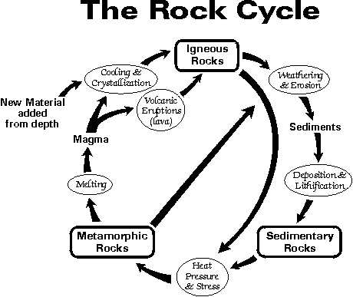
5 - b. The Rock Cycle
The rock cycle is an ongoing process, beginning as rocks are pushed up by tectonic forces,
and eroded by wind and rain.
The eroded rocks travel by wind or moving water until they are deposited, settling into layers.
More eroded rocks may squeeze and press the layers into sedimentary rocks.
Additional eroded rocks may bury these layers until heat and pressure
change the underlying layers to metamorphic rock.
Buried rocks may also melt and recrystallize into igneous rocks.
Rocks can also be sunk down into the lower layers of the earth by plate tectonic processes.
Metamorphic, sedimentary, and igneous rocks may then be pushed up by tectonic forces,
starting the rock cycle again.
The Olympiad site has information on the rock cycle
or
GOOGLE the rock cycle – there are many sites with information on it.

Slide 22
5 – e. The formation and difference between
the coal varieties on the list
http://www.eia.gov/KIDS/ENERGY.CFM?PAGE=COAL_HOME-BASICS
general information
https://www.uky.edu/KGS/coal/coal_information.htm
The top 4 under General coal information will work for Division A
http://teachcoal.org/energy-and-you/how-coal-is-formed-2/
quick slideshow

Slide 23
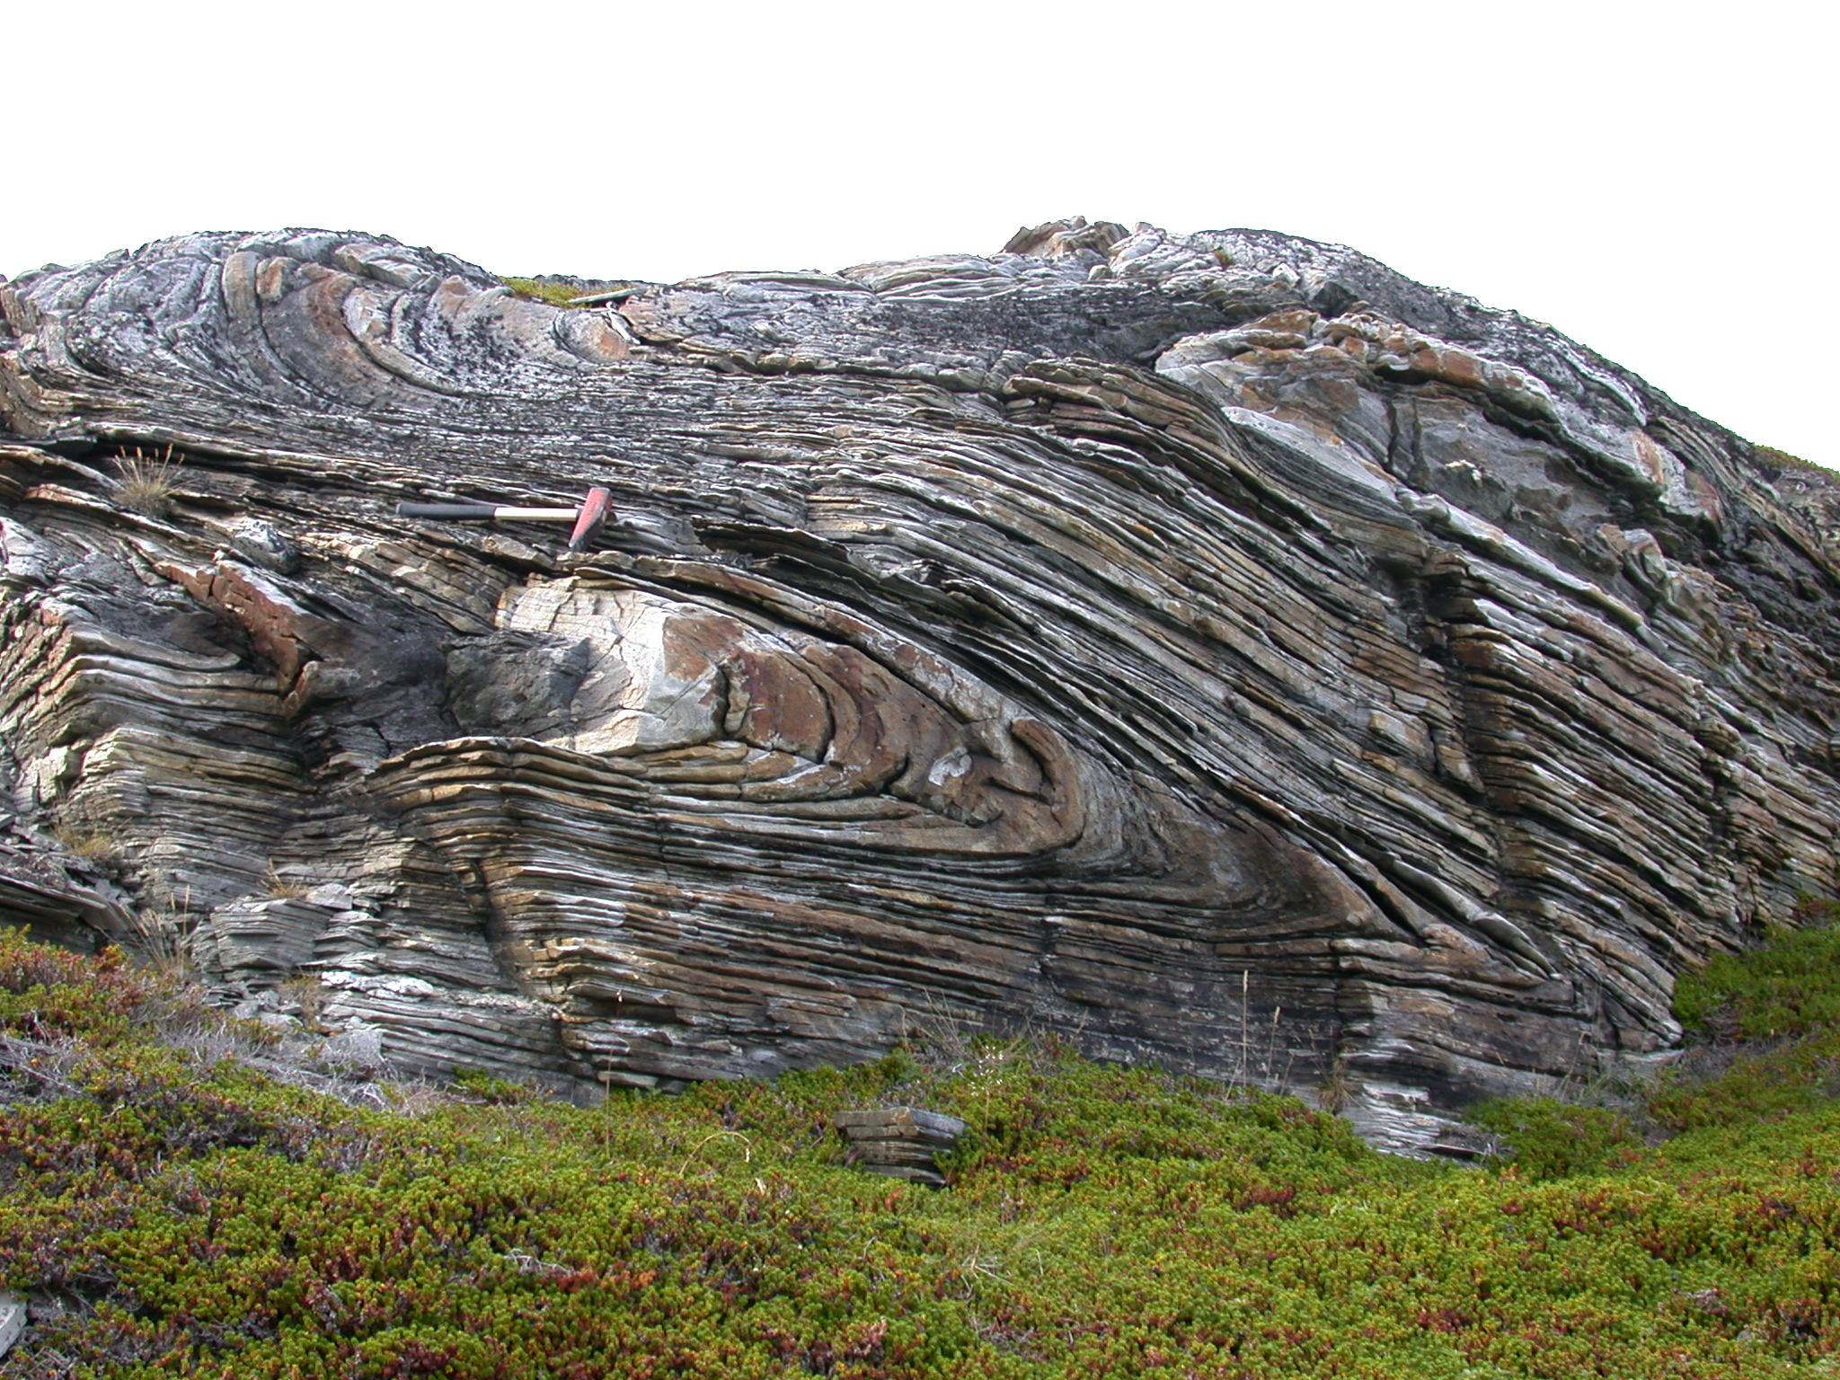
5 - d. Grade of Metamorphism
http://www.oakton.edu/user/4/billtong/eas100lab/metrxsum.htm
Note the type of metamprphism
http://www.middleschoolscience.rocks/lessons/metamorphic_rock
Note the temperature of metamorphism

Slide 24
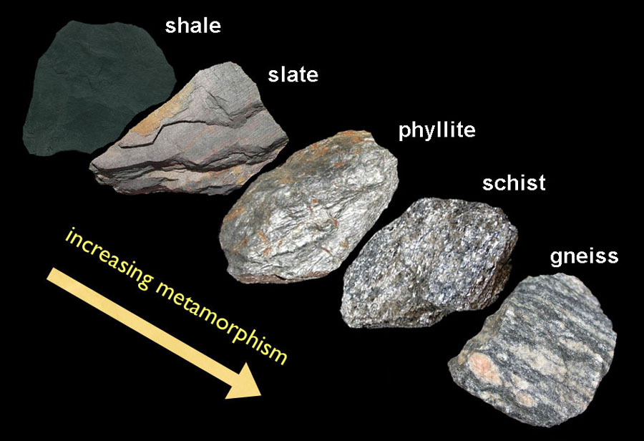
http://geologycafe.com/class/chapter10.html
The parent rock of slate is shale:
a sedimentary rock

Slide 25
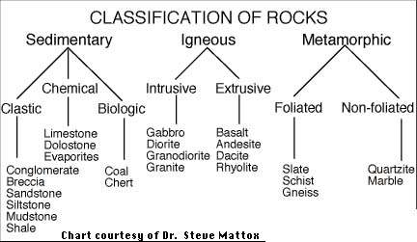
5 - e. Classification of: Sedimentary, igneous and metamorphic Rocks
http://volcano.oregonstate.edu/book/export/html/196
A good site for information on rocks
Here are charts to give you an idea
http://scienceviews.com/geology/rockclassificationchart.html
http://jersey.uoregon.edu/~mstrick/MinRockID/RockID/RockIDChart.html
http://www.archaeology.ncdcr.gov/ncarch/GeoArcheo/Home.htm
Click on the “ figure it out ” links on the left side of the page for each class of rock
There is also a flow chart for the identification of rocks.

Slide 26
5 - e. Classification of: Igneous Rocks
http://facweb.bhc.edu/academics/science/harwoodr/geol101/labs/Igneous/index.htm
A good chart for Igneous Rocks

Slide 27
5 - e. Classification of: Sedimentary Rocks
http://jersey.uoregon.edu/~mstrick/MinRockID/RockID/Sedimentary.html
https://commons.wvc.edu/rdawes/basics/BscsTables/sedimentary.html
http://core.ecu.edu/geology/harper/Metamorphic/metamorphic_new.cfm
Charts for Sedimentary Rocks

Slide 28
5 - e. Classification of: Metamorphic Rocks
http://jersey.uoregon.edu/~mstrick/MinRockID/RockID/MetaClass.html
A good chart for Metamorphic Rocks
http://faculty.chemeketa.edu/afrank1/rocks/metamorphic/metaclass.htm
A site showing the progression of Metamorphic Rocks

Slide 29
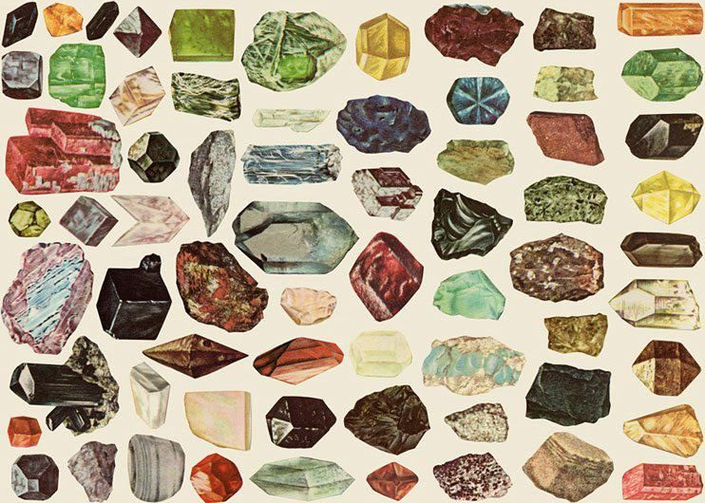
5. Minerals: Identification
http://skywalker.cochise.edu/wellerr/mineral/minlist.htm

Slide 30
National Audubon Society Field Guide to Rocks and Minerals
Peterson Field Guides Rocks and Minerals
Simon and Schuster’s Guide to Rocks & Minerals
Any of the field guides will give information and have pictures of the minerals on the list.
I would recommend buying the guides ( if possible ) and having the students browse through them several times,
as well as looking at pictures on line
to get an idea of the different colors and habit the same mineral on the list can be.

Slide 31
5 – f. Methods & environments of formation
• Minerals form in a variety of ways, in different environments.
• Crystallization from melt (igneous rocks)
• Precipitation from water
— Evaporation of sea water forming chemical sedimentary rock
such as gypsum rock salt
— Hydrothermal ore deposits
• Chemical alteration during weathering or metamorphism
• Precipitation from a vapor — ex. Sulfur in a volcanic region
http://www.minsocam.org/msa/collectors_corner/id/mineral_id_keyi12.htm
go to the table of contents http://www.minsocam.org/msa/collectors_corner/id/mineral_id_keyi1.htm#TOC
for other information on minerals
* You need to know the method of formation of each mineral on the list
The field guides are the best place to find this information

Slide 32
Moh’s hardness scale
Mohs Hardness
of Common Objects
Piece of chalk 1
Plaster of Paris 2
fingernail 2 to 2.5
copper penny 3
iron nail 4
window glass 5.5
knife blade 5 to 6.5
steel file 6.5
streak plate 6.5 to 7
quartz 7
Hardened steel file 7+
The Olympiad site and the web have a lot of information on Moh’s hardness scale.
Minerals above a hardness of 6.5 cannot be tested for streak on a streak plate.

Slide 33
5 – h. Mineral habit
is the most commonly found shape or form that a mineral adopts.
Mineral Habit
Discussions of crystal habit are more descriptive than precise;
In nature perfect crystals are rare.
Crystals sometimes develop certain forms more commonly than others.
Symmetry may not be readily apparent from these common forms.
A few common crystal habits are as follows :
http://www.tulane.edu/~sanelson/eens211/physprop.htm
* You need to know the mineral habit of each mineral on the list
The field guides are the best place to find this information

Slide 34
5 – h. Mineral habit examples ( not all minerals here are on the 2017 list )
Individual
Acicular - long, slender needlelike crystals. ( chrysotile, natrolite )
Bladed - like a wedge or knife blade. ( stibnite )
Cubic - cube shapes ( pyrite, galena, halite )
Drusy - a surface covered with a layer of small crystals. ( quartz, lining the inside of a geode )
Equant - minerals that have all of their boundaries of approximately equal length. ( garnet )
Octahedral - shaped like 2 pyramids joined at the base ( diamond )
Prismatic - abundance of prism faces - 3 to 6 sides. (tourmaline, topaz )
Prismatic - with pyramid like ends ( quartz - amethyst, citrine )
Tabular - like a pad of paper or deck of cards. ( barite )
Groups
Botryoidal - smooth bulbous or globular shapes. ( azurite, malachite )
Dendritic - tree-like growths. ( copper )
Fibrous - elongated clusters of fibers. ( tremolite )
massive - homogenous masses ( limonite )
Mecaseous - splits into very thin sheets ( muscovite (mica) )
Twinning - Crystals that are related to one another by a geometric relation. ( albite, staurolite )
Striated - Not a habit per se, ( tourmaline, feldspar )
but a condition of paralell lines that can occur on certain crystal faces
on certain minerals.
* You need to know the mineral habit of each mineral on the list
http://www.galleries.com/minerals/property/habits.htm#acicular
The field guides are the best place to find this information

Slide 35
5 – i. Economic importance
Minerals can be found in abundance in Earth’s crust.
These minerals are important for humans.
Some, such as calcium and iron, are required for diet.
Others are necessary for the functioning of our society.
This is because practically every manufactured product
contains material obtained from minerals.
Obvious examples are aluminum in beverage cans,
gold and silver in jewelry,
and copper in electrical wiring.
Baby powder is essentially the ground up mineral talc.
Many industrial drill bits are composed of diamonds,
which is one of the hardest minerals on Earth.
As well, the common mineral quartz is the major ingredient
in both glass and silicon, which is used for computer chips.
* You need to know the economic importance of each mineral on the list
http://geology.com/minerals/
This link can help with the economic importance of a mineral by clicking on the individual mineral,
as well as other information about it
The field guides are the best place to find this information

Slide 36
6. Representative Station Activities:
j. Identify each of the minerals
and place them in the correct order according to Moh’s scale
k. Match each metamorphic rock
with the type of rock from which it may have been formed

Slide 37
7. SCORING:
Total highest scores will determine rankings in this event.
Ties will be broken by the accuracy or quality of answers to pre-selected questions.

Slide 38
The correct answers for the properties of Rocks & Minerals
will be taken from the AUDUBON FIELD GUIDE
– Not From Wiki blogging!
Questions and Tie Breakers - will be related to Rocks & minerals on the list,
but will be of a more general means derived from:
past tests
tests from other locations
information from the rocks & minerals CD
related on line sources

Slide 39
How to prepare
for the event !

Slide 40
Knowledge isn’t
memorizing massive amounts of information.
It’s knowing where to look it up.
For this event, quickly!

Slide 41
Here is some advice on how to prepare your students for this event.
Show them a path to follow. Try to get them to do a little bit each week.
Get them to commit to dedicating maybe 1 or 2 days a week
to spend a ½ hour or so on creating the binder.
------------------------------------------------------------------------------------------------
Eat the elephant one bite at a time.
------------------------------------------------------------------------------------------------
Give them weekly assignments to complete.
They will respond to a guideline.
They will need to see for themselves if they will be ready when the competition arrives.
You need to keep a record of their progress to keep them on track.
I had a big binder with all the events I coached.
I had the evidence to show them if they were falling behind.
I could get them to commit to getting to the next portion of the event
I knew where each team was and who needed motivation.
If you can... Get a calendar!
Have them create their own syllabus, showing when they will achieve set goals,
to complete certain sections of their binder ( study – building project – etc. ) !

Slide 42
Separate the responsibility for gathering the information
amongst the team members.
Don’t let one person do it all !!!!
Set up 2 minute practice drills,
so they have an idea of what it’s like to move
in a station orientated event.
If you can, find a way to get the parents involved.
Get them to meet after school hours at someone’s home.
Have them make up or download flash cards.
Parents can ask them to identify the specimens or answer questions.

Slide 43
I highly recommend...
If possible, get samples.
Have your students get hands on experience with rocks and minerals.
Recommended Resources:
All Science Olympiad reference and training resources if possible...
the Rocks and Minerals kits which may be ordered from Ward's Science Olympiad Kits
the Rocks and Minerals CD and coaches handbook
including any one ( or all ) of the following guides:
1. The National Audubon Society Field Guide to North American Rocks and Minerals,
2. Peterson Field Guide to Rocks and Minerals
3. Simon & Schuster's Guide to Rocks & Minerals
( and other field guides, anything with pictures )
SPECIAL NOTE: I will be using the Audubon guide for all relevant information.
If any appeals occur, be advised the Audubon guide will be the source of resolution.
and
GO ONLINE - LOOK AT PICTURES!

Slide 44
I highly recommend...
MAKE A BINDER
Separate the binder into sections with tabs
tab the binder for:
quick Identification of the minerals by class, color or both
then - igneous, sedimentary and metamorphic rocks
HAVE THE ROCKS AND MINERALS LIST AND A GLOSSARY OF TERMS
http://www.delawarescienceolympiad.com/
information on Bowen’s reaction series and the rock cycle
– questions in general you may not be sure of and any miscellaneous information you may want to include
Make it easy to find the section you want
to quickly identify the specimen, in your binder.

Slide 45
Use These Templates

Slide 46
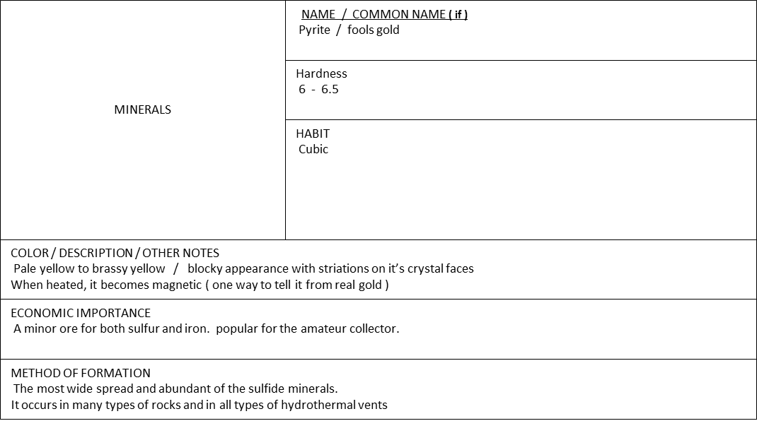
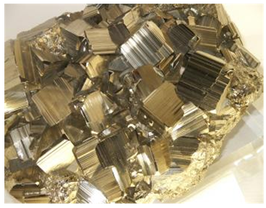
MINERALS
NAME & COMMON NAME ( if )
Hardness
HABIT
COLOR / DESCRIPTION / OTHER NOTES
ECONOMIC IMPORTANCE
METHOD OF FORMATION

Slide 47
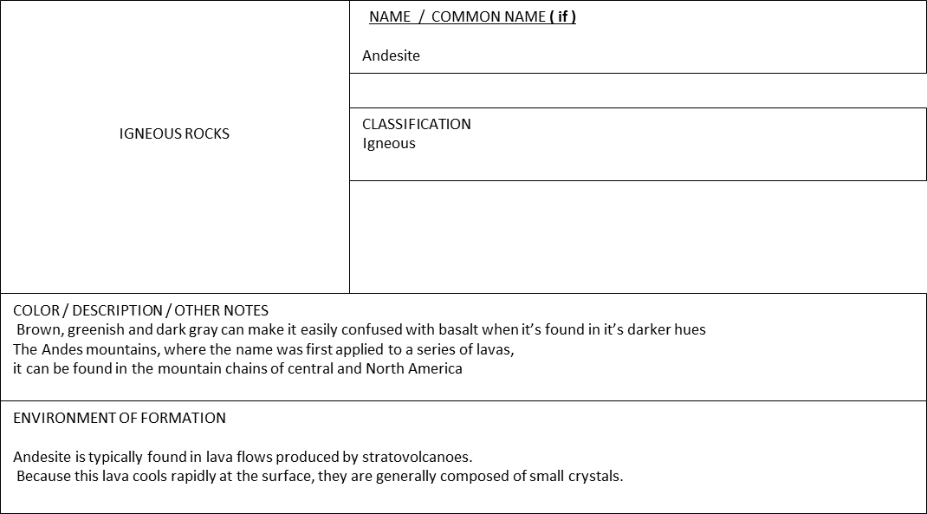
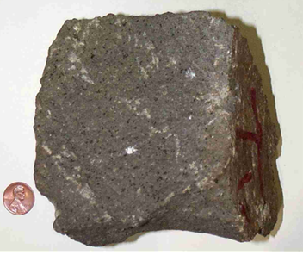
IGNEOUS ROCKS
NAME & COMMON NAME ( if )
CLASSIFICATION
COLOR / DESCRIPTION / OTHER NOTES
ENVIRONMENT OF FORMATION

Slide 48

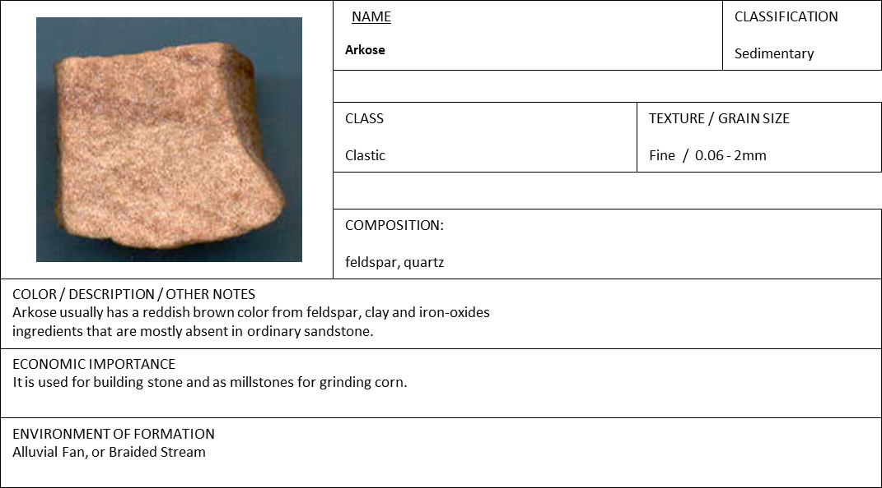
SEDIMENTARY ROCKS
NAME & COMMON NAME ( if )
CLASSIFICATION
COLOR / DESCRIPTION / OTHER NOTES
ENVIRONMENT OF FORMATION

Slide 49

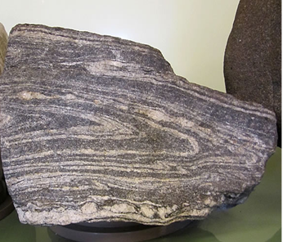
CLASSIFICATION
Metamorphic
Grade of Metamorphism
High
Parent Rock
Schist
METAMORPHIC ROCKS
NAME / COMMON NAME ( if )
CLASSIFICATION
Grade of Metamorphism
Parent Rock
COLOR / DESCRIPTION / OTHER NOTES
ENVIRONMENT OF FORMATION

Slide 50
HINTS!
Read all the questions first, before answering them!
Often there are similar questions that will point you in the right direction.
If you don’t know the answer to one question, don’t give up.
You can’t go back to a station you’ve already been to,
but you can take time later if
you’ve answered all the questions at another station quickly.
Talk softly, you may give the answer to your competition!

Slide 51
Coaches only, please.
Students, your coaches may already know the answer to your questions.
I can be reached by email at
genepulcher@verizon.net
P.S. Right click the blank boxes for minerals and rocks and click copy.
Open WORD.
Right click on the page, then click under “Paste Options”
the box on the left, “use destination theme”.
The boxes should paste onto the page
and you can type your information into them.
You can get 2 per page to put into your binders.

